Slide 1
Delhi is projected to continue growing and to become the most populous city in the world around 2028.
-World Urbanization Prospects 2018

Slide 2
But… Are we prepared ?

Slide 3


Slide 4
What else does other reports says ?

Slide 5
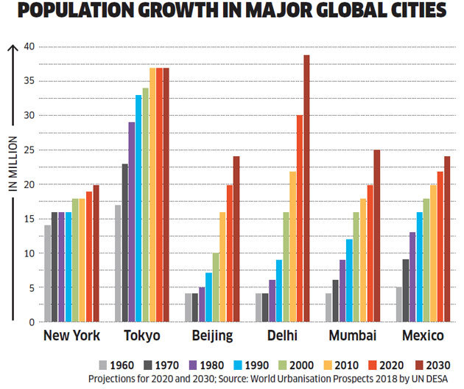

Slide 6
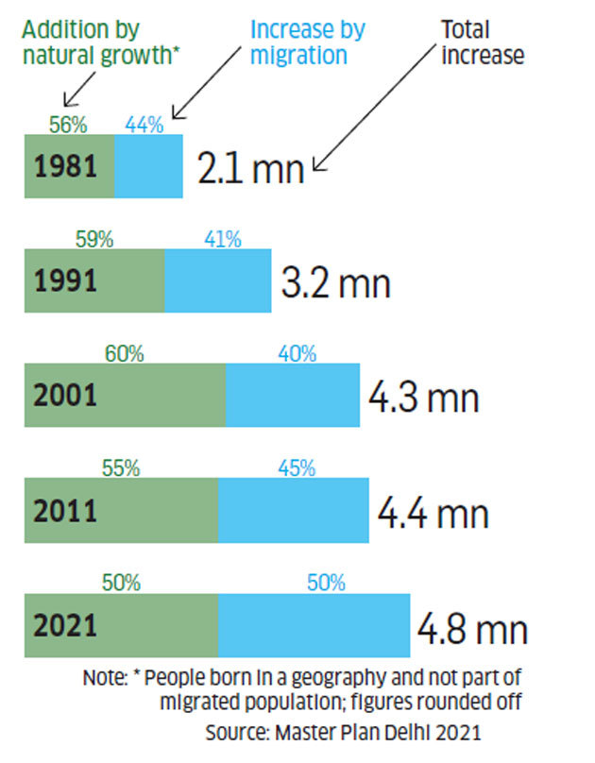

Slide 7
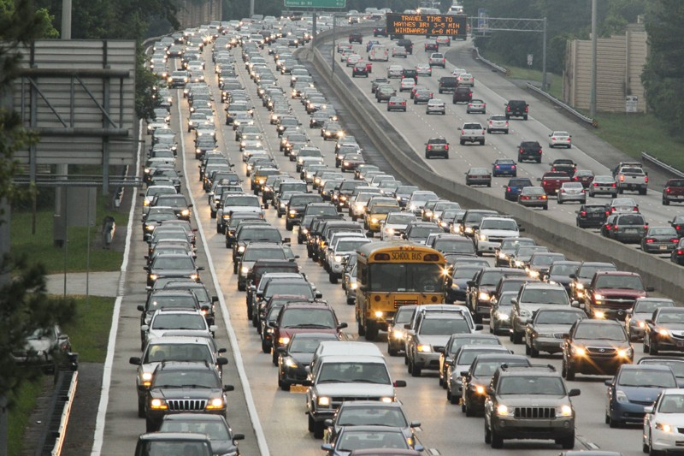

Slide 8
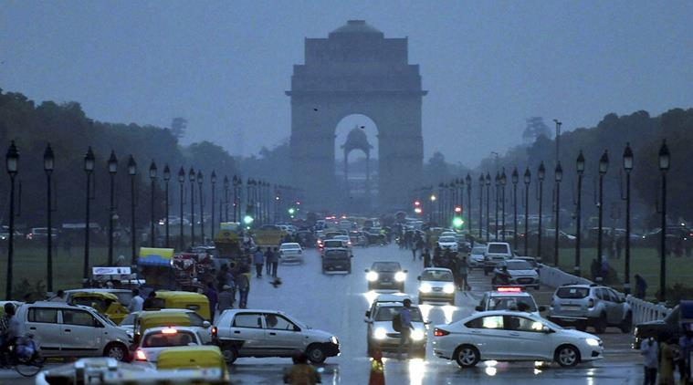
Delhi Population Control
Some Data based suggestions to Government of India

Slide 9
A Capstone Project
by
Uday Pratap Singh

Slide 10
Delhi & The problem..
Delhi, officially the National Capital Territory of Delhi (NCT), is a city and a union territory of India containing New Delhi, the capital of India. It is bordered by Haryana (Gurugram, Faridabad, Jhajjar and Sonipat) on three sides and by Uttar Pradesh (Gautam Budh Nagar, Ghaziabad and Baghpat) to the east. As of 2016, recent estimates of the metro economy of its urban area have ranked Delhi either the most or second-most productive metro area of India. Delhi is the second-wealthiest city in India after Mumbai and is home to 18 billionaires and 23,000 millionaires. Delhi ranks fifth among the Indian states and union territories in human development index. Delhi has the second-highest GDP per capita in India.
However….

Slide 11
Delhi & The problem..
Delhi is also one of the most polluted cities in India. Delhi faces many other issues too. One of the main root causes is its huge population. Delhi had an estimated 2016 population of over 26 million people, making it the world's third-largest urban area according to United Nations. Increased rate of population growth in Delhi is a matter of concern. Delhi also has huge population of daily or frequent visitors, which makes the situation worse. This is already showing result as shortage of resources, increase in pollution, system breakdowns, etc.

Slide 12
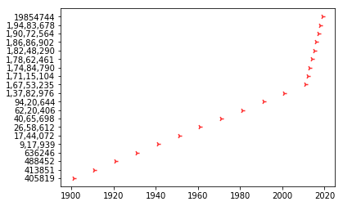
Delhi & The problem..
Where Growth rate increased, tremendously.
Population of Delhi
Year versus population Diagram, above, displays How population have always been increasing, but in in past few years, growth rate has been tremendously high.
Year

Slide 13
Understanding Population & the solution..
There are mainly 2 kind of population in Delhi, that significantly contributes to pollution and other issues:
Who are resident of Delhi. These are further of 2 kind:
- Who are by birth, resident of Delhi.
- who have moved to Delhi for Job or Business.
Who regularly visit Delhi.
One thing common in all of above is that they have some incentive to live in or visit Delhi: whether it is career, or best quality health care service of AIIMS, or anything else. Problem of Delhi can be solved if we can provide these incentive, at much more convenient location outside Delhi, to above mentioned population.

Slide 14

The Incentives..
Four most common type incentives are:
Connectivity and availability.
Education.
Healthcare.
Professional Career.

Slide 15
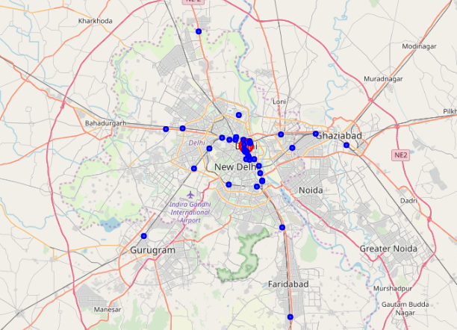
1) Connectivity and Availability..
Data Says: No railway station in Noida or Greater Noida.
Railway travelers will have to deboard train at Delhi or Ghaziabad station to get to Noida. Thus, Noida and greater Noida will be less preferred, and will be avoided.

Slide 16
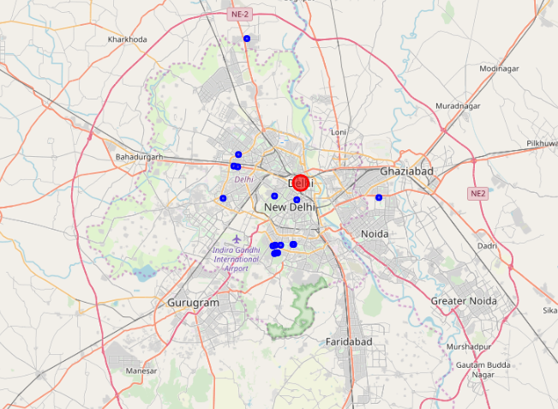
2) Education..
Data Says: Best institutions of country are densely situated in Delhi, while few in surrounding.
Even though NCR region is known for quantity of private institutions, still lack of best quality institutions as compared to Delhi make these places much less attractive than Delhi.

Slide 17
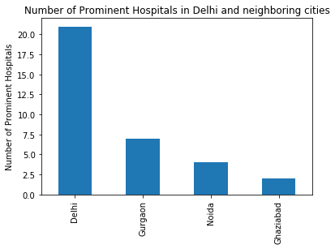
3) Healthcare..
Data Says: There is a huge difference in number of prominent healthcare services in Delhi and that of in neighbouring cities.
Neighbouring cities are incapable of attracting public, to their hospitals, as much as Delhi do.

Slide 18
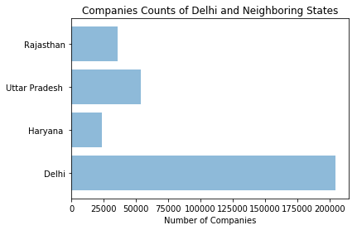
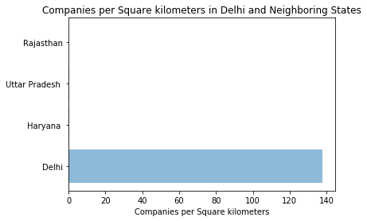
4) Professional Career..
Data Says: Companies' densities are almost negligible in Delhi’s neighbouring states when compared to companies’ density of Delhi.
As most employers have offices in Delhi, thus employment will attract a huge population to be a resident of Delhi.

Slide 19
Conclusion
Growing population of Delhi is a serious matter of concern; following steps may help, up to some extent to decelerate the population growth:
There must be a railway station in Noida or greater Noida, so that people do not need to enter Delhi, if Noida, with a railway station, is more convenient to them.
With quantity, NCR and nearby cities also need some best quality education bodies to attract people as much as Delhi do.
All the neighbouring cities of Delhi need more quantity of prominent hospitals, to divert public from Delhi to these cities.
Policies should be made to attract new companies and old well settled companies to build their offices and provide employment in different cities of these neighbouring states.

Slide 20
Data Sources
https://foursquare.com/
https://data.gov.in/
https://en.wikipedia.org/wiki/List_of_hospitals_in_India
https://propstory.com/top-5-hospitals-in-noida/
www.mca.gov.in/.../Monthly_Information_Bulletin_CorporateSector_Jan_2016.pdf
https://www.un.org/development/desa/publications/2018-revision-of-world-urbanization-prospects.html
https://economictimes.indiatimes.com/news/politics-and-nation/delhi-could-be-the-worlds-most-populous-city-by-2028-but-is-it-really-prepared/articleshow/68027790.cms?from=mdr
Disclaimer:
Some data may not be totally accurate, but data are accurate enough to give us the real scenario insights.

Slide 21
Thank You.
Questions and suggestions are welcome.

